Slide 1


Fake News Detection
By,
Manoj.I.V,
Data Trained,
Fliprobo Technologies

Slide 2
Customer Information About The Data
Context Fake News Has Become One Of The Biggest Problems Of Our Age. It Has Serious Impact On Our Online As Well As Offline Discourse. One Can Even Go As Far As Saying That, To Date, Fake News Poses A Clear And Present Danger To Western Democracy And Stability Of The Society.
-Content What's Inside Is More Than Just Rows And Columns. Make It Easy For Others To Get Started By Describing How You Acquired The Data And What Time Period It Represents, Too. What Is A Fake News? Fake News's Simple Meaning Is To Incorporate Information That Leads People To The Wrong Path. Nowadays Fake News Spreading Like Water And People Share This Information Without Verifying It. This Is Often Done To Further Or Impose Certain Ideas And Is Often Achieved With Political Agendas. For Media Outlets, The Ability To Attract Viewers To Their Websites Is Necessary To Generate Online Advertising Revenue. So It Is Necessary To Detect Fake News.
-Workflow
In This Project, We Are Using Some Machine Learning And Natural Language Processing Libraries Like Nltk, Re (Regular Expression), Scikit Learn
-Natural Language Processing Machine Learning Data Only Works With Numerical Features So We Have To Convert Text Data Into Numerical Columns. So We Have To Preprocess The Text And That Is Called Natural Language Processing. In-text Preprocess We Are Cleaning Our Text By Steaming, Lemmatization, Remove Stopwords, Remove Special Symbols And Numbers, Etc. After Cleaning The Data We Have To Feed This Text Data Into A Vectorizer Which Will Convert This Text Data Into Numerical Features.
-Dataset You Can Find Many Datasets For Fake News Detection On Kaggle Or Many Other Sites. I Download These Datasets From Kaggle. There Are Two Datasets One For Fake News And One For True News. In True News, There Is 21417 News, And In Fake News, There Is 23481 News. You Have To Insert One Label Column Zero For Fake News And One For True News. We Are Combined Both Datasets Using Pandas Built-in Function.
Some Useful Links- 1-https://Www.Javatpoint.Com/Nlp 2-https://Www.Educative.Io/Answers/Preprocessing-steps-in-natural-language-processing-nlp 3-https://Www.Youtube.Com/Watch?V=5ctbvkamqo4 4-https://Www.Youtube.Com/Watch?V=x2vaabgkium

Slide 3
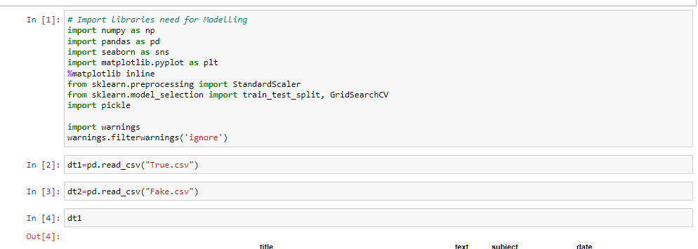
Importing Libraries

Slide 4
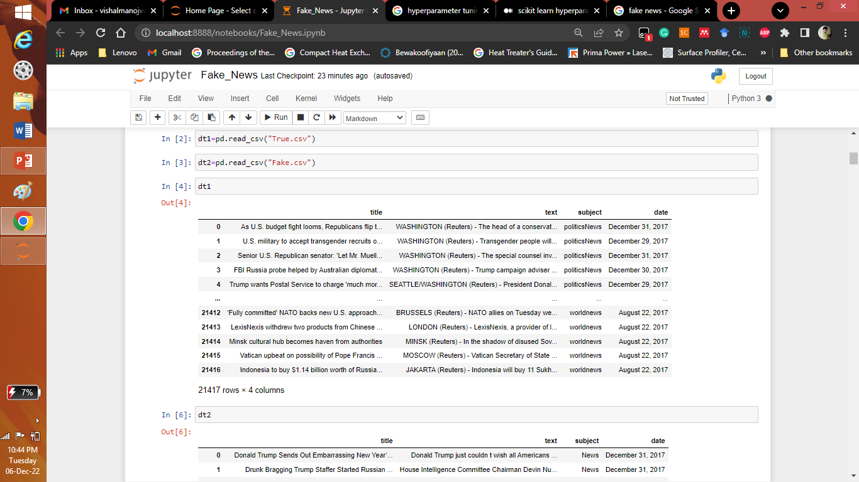
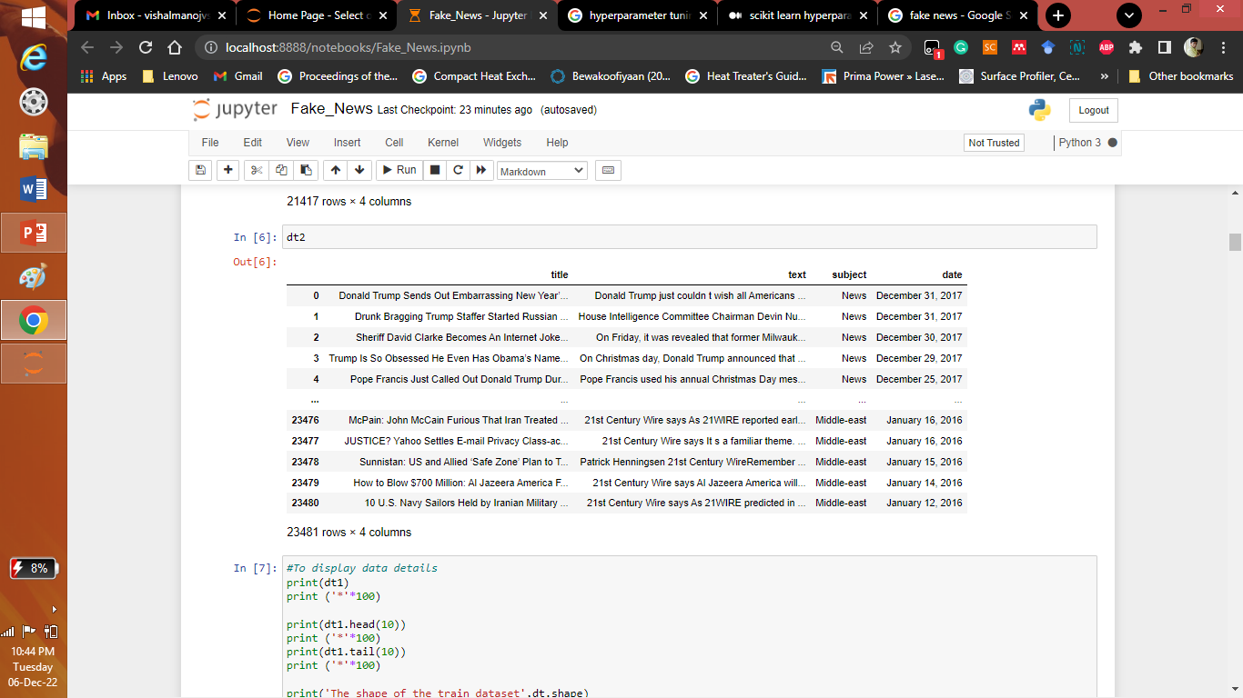
Importing Data into Python Notebook

Slide 5
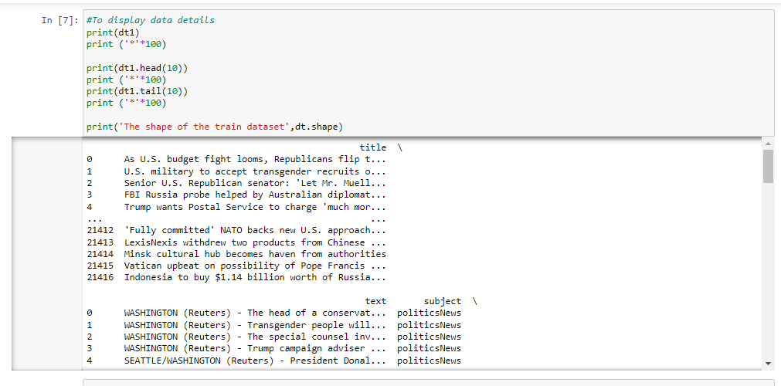

Displaying the data

Slide 6
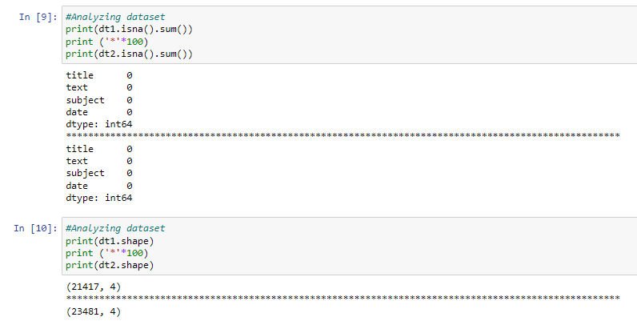
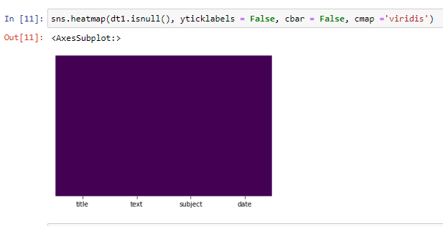
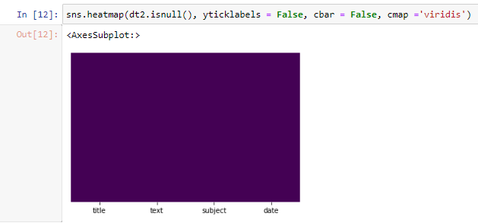
Data Exploration

